Slide 2
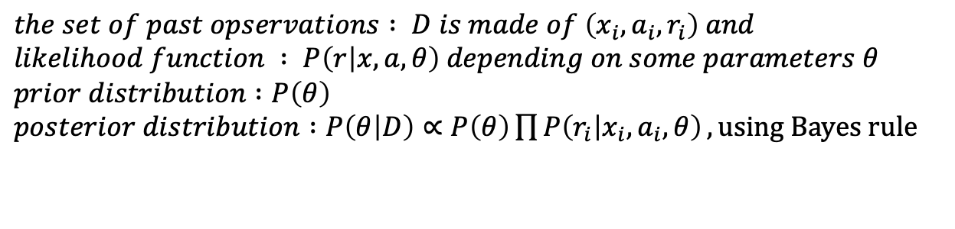
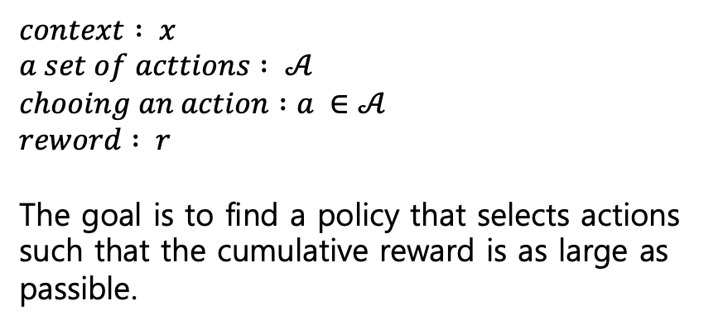
Thompson Sampling
$context : x$
$a set of acttions : 𝒜$
$chooing an action :a ∈𝒜$
$reword : r$
The goal is to find a policy that selects actions such that the cumulative reward is as large as passible.
$the set of past opservations : D is made of \left(x_{i},a_{i},r_{i}\right) and$
$likelihood function : P\left(r | x,a,θ\right) depending on some parameters θ$
$prior distribution :P\left(θ\right)$
$posterior distribution :P\left(θ | D\right)∝P\left(θ\right)\prod{P\left(r_{i} | x_{i},a_{i},θ\right)}, using Bayes rule$
In the realization case, the reward is a stochastic function of the action, context and the unknown, true parameter $θ^{∗}$

Slide 3
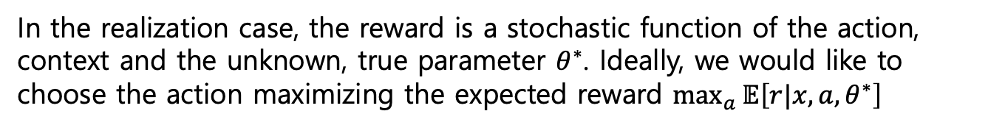
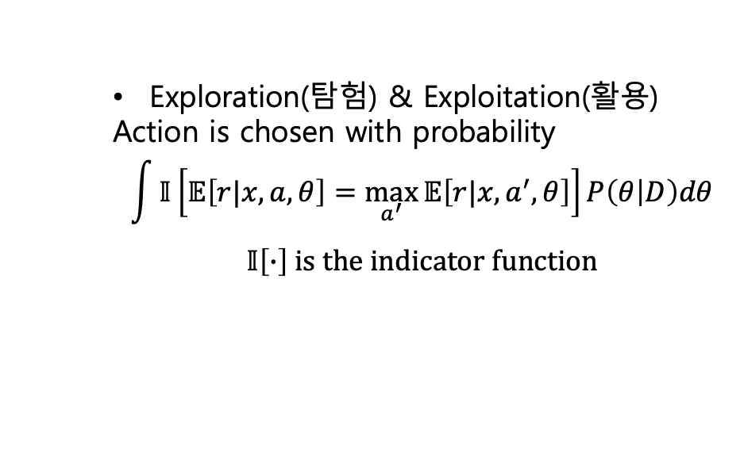
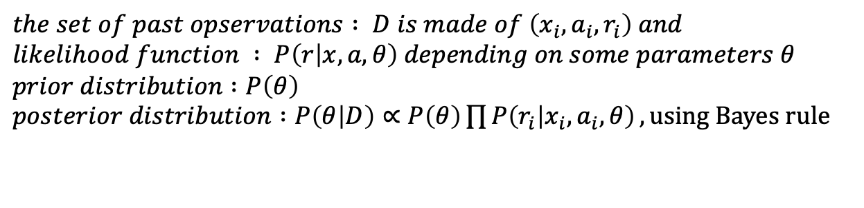
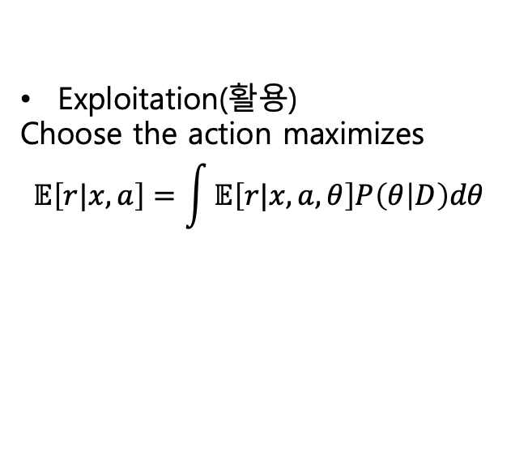
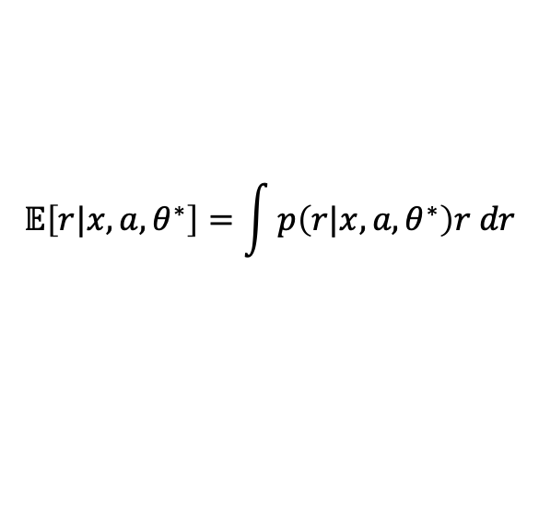
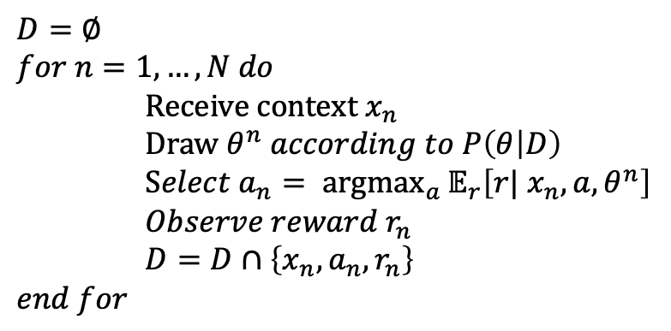
$the set of past opservations : D is made of \left(x_{i},a_{i},r_{i}\right) and$
$likelihood function : P\left(r | x,a,θ\right) depending on some parameters θ$
$prior distribution :P\left(θ\right)$
$posterior distribution :P\left(θ | D\right)∝P\left(θ\right)\prod{P\left(r_{i} | x_{i},a_{i},θ\right)}, using Bayes rule$
$$𝔼\left[r|x,a,θ^{∗}\right]=\int{p\left(r|x,a,θ^{∗}\right)r dr}$$
In the realization case, the reward is a stochastic function of the action, context and the unknown, true parameter $θ^{∗}$. Ideally, we would like to choose the action maximizing the expected reward $\max_{a}{𝔼\left[r|x,a,θ^{∗}\right]}$
Exploitation(활용)
Choose the action maximizes
$$𝔼\left[r|x,a\right]=\int{𝔼\left[r|x,a,θ\right]P\left(θ | D\right)dθ}$$
$D=∅$
$for n=1,…,N do$
$Receive context{ x}_{n}$
$Draw θ^{n} according to P\left(θ | D\right)$
$Select a_{n}= \underset{a}{argmax}{𝔼_{r}\left[r|{ x}_{n},a,θ^{n}\right]}$
$Observe reward r_{n}$
$D=D∩\left\{x_{n},a_{n},r_{n}\right\}$
$end for$
Exploration(탐험) & Exploitation(활용)
Action is chosen with probability
$$\int{𝕀\left[𝔼\left[r|x,a,θ\right]=\max_{a^{′}}{𝔼\left[r|x,a^{′},θ\right]}\right]P\left(θ | D\right)dθ}$$
$$𝕀\left[∙\right] is the indicator function$$

Slide 4
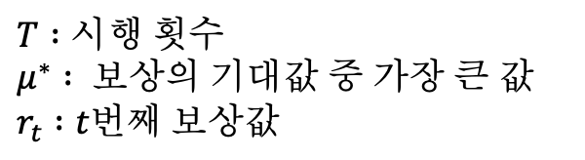
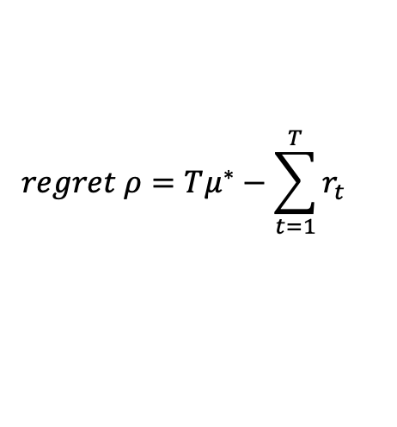
$T :시행 횟수$
$μ^{∗} : 보상의 기대값 중 가장 큰 값$
$r_{t} :t번째 보상값$
$$regret ρ=Tμ^{∗}−\sum_{t=1}^{T}{r_{t}}$$

Slide 5
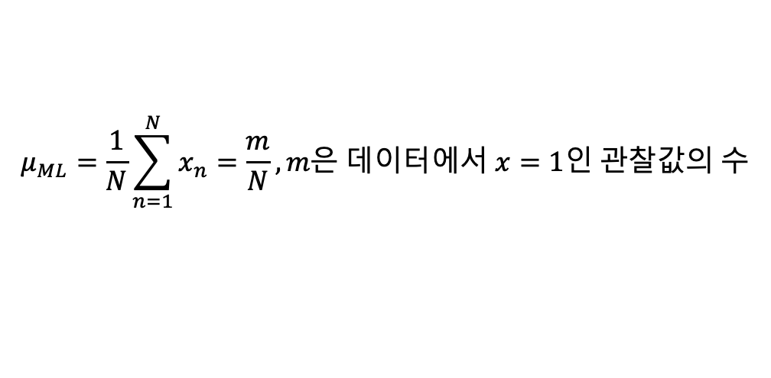
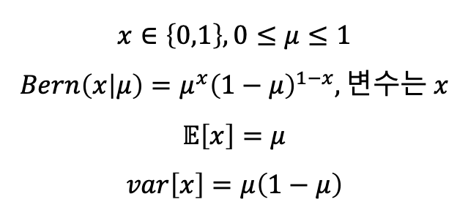
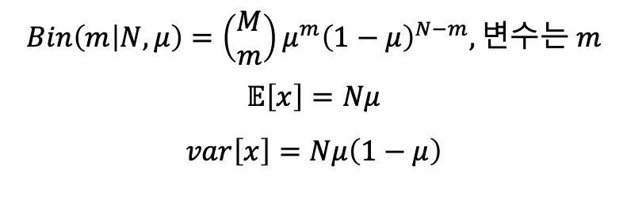
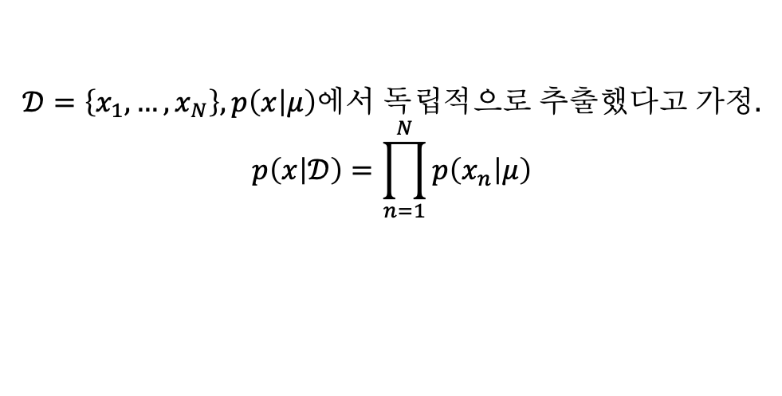
베르누이 분포
이항분포
$$x∈\left\{0,1\right\}, 0≤μ≤1$$
$$Bern\left(x | μ\right)=μ^{x}{\left(1−μ\right)}^{1−x}, 변수는 x$$
$$𝔼\left[x\right]=μ$$
$$var\left[x\right]=μ\left(1−μ\right)$$
$$Bin\left(m | N,μ\right)=\left(\begin{aligned}M \\ m\end{aligned}\right)μ^{m}{\left(1−μ\right)}^{N−m}, 변수는 m$$
$$𝔼\left[x\right]=Nμ$$
$$var\left[x\right]=Nμ\left(1−μ\right)$$
$$𝒟=\left\{x_{1},…,x_{N}\right\}, p\left(x | μ\right)에서 독립적으로 추출했다고 가정.$$
$$p\left(x | 𝒟\right)=\prod_{n=1}^{N}{p\left(x_{n} | μ\right)}$$
$$μ_{ML}=\frac{1}{N}\sum_{n=1}^{N}{x_{n}}=\frac{m}{N}, m은 데이터에서 x=1인 관찰값의 수$$

Slide 6
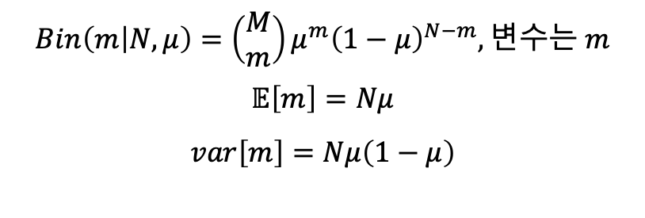
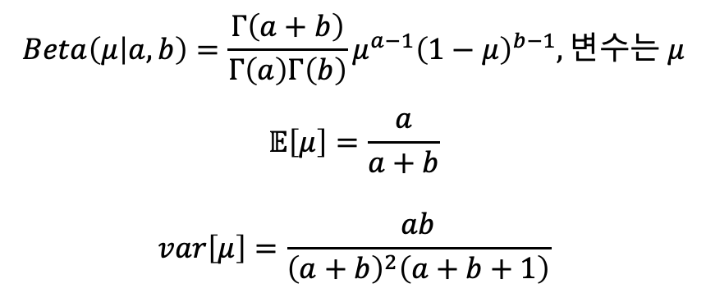

이항분포
베타 분포
$$Beta\left(μ | a,b\right)=\frac{Γ\left(a+b\right)}{Γ\left(a\right)Γ\left(b\right)}μ^{a−1}{\left(1−μ\right)}^{b−1}, 변수는 μ$$
$$𝔼\left[μ\right]=\frac{a}{a+b}$$
$$var\left[μ\right]=\frac{ab}{{\left(a+b\right)}^{2}\left(a+b+1\right)}$$
$$Bin\left(m | N,μ\right)=\left(\begin{aligned}M \\ m\end{aligned}\right)μ^{m}{\left(1−μ\right)}^{N−m}, 변수는 m$$
$$𝔼\left[m\right]=Nμ$$
$$var\left[m\right]=Nμ\left(1−μ\right)$$
$$p\left(w | 𝒟\right)∝p\left(𝒟 | w\right)p\left(w\right)$$
$$p\left(μ | N,m,a,b\right)∝ Bin\left(m | N,μ\right)Beta\left(μ | a,b\right)$$
$$p\left(μ | l,m,a,b\right)=\frac{Γ\left(m+a+l+b\right)}{Γ\left(m+a\right)Γ\left(l+b\right)}μ^{m+a−1}{\left(1−μ\right)}^{l+b−1}, 변수는 μ, l=N−m$$

Slide 7
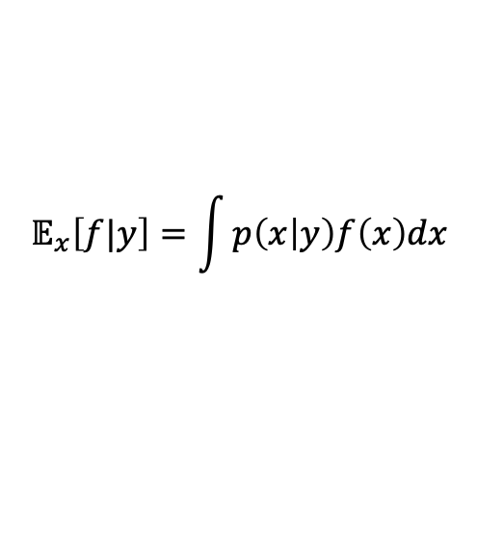

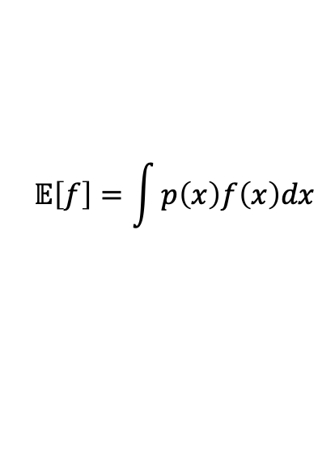



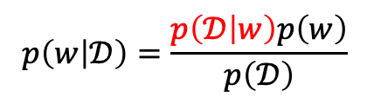

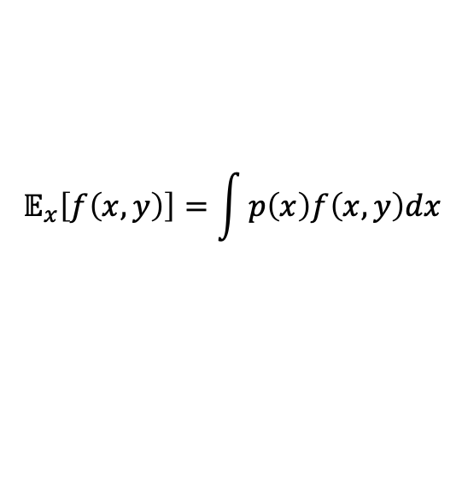
$$𝔼\left[f\right]=\int{p\left(x\right)f\left(x\right)dx}$$
베이즈 이론의 의미는 믿음(확률)은 변한다?
$$𝒟는 데이터 집합$$
$$w는 모델 매개변수$$
$$𝔼_{x}\left[f\left(x,y\right)\right]=\int{p\left(x\right)f\left(x,y\right)dx}$$
$$p\left(w | 𝒟\right)∝p\left(𝒟 | w\right)p\left(w\right)$$
$$p\left(w | 𝒟\right) : posterior$$
$$𝔼_{x}\left[f|y\right]=\int{p\left(x | y\right)f\left(x\right)dx}$$
$$p\left(w\right) :prior$$
$$p\left(𝒟 | w\right) :likelihood$$
$$p\left(w | 𝒟\right)=\frac{p\left(𝒟 | w\right)p\left(w\right)}{p\left(𝒟\right)}$$

Slide 8
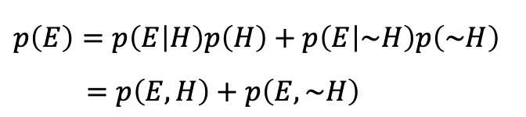
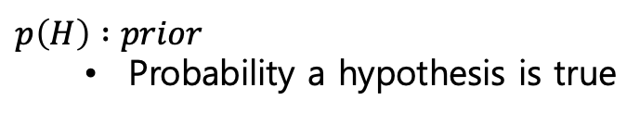
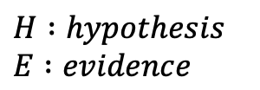
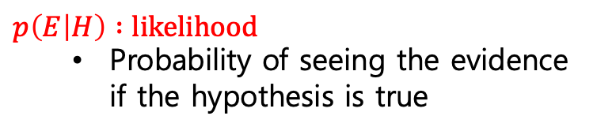
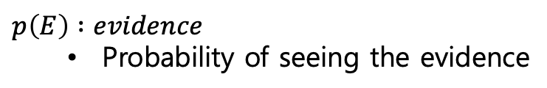
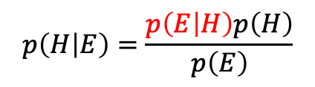
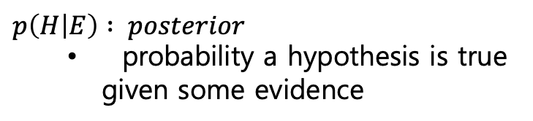

$H :hypothesis$
$E :evidence$
$p\left(H\right) :prior$
Probability a hypothesis is true
$$p\left(H | E\right)∝p\left(E | H\right)p\left(H\right)$$
$$p\left(H | E\right)=\frac{p\left(E | H\right)p\left(H\right)}{p\left(E\right)}$$
$p\left(E | H\right) :likelihood$
Probability of seeing the evidence if the hypothesis is true
$p\left(E\right) :evidence$
Probability of seeing the evidence
$p\left(E\right)=p\left(E | H\right)p\left(H\right)+p\left(E | \sim H\right)p\left(\sim H\right)$
$=p\left(E,H\right)+p\left(E,\sim H\right)$
$p\left(H | E\right) : posterior$
probability a hypothesis is true given some evidence

Slide 9
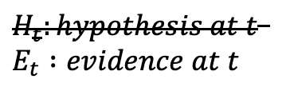

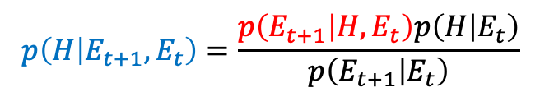
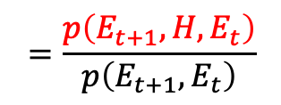
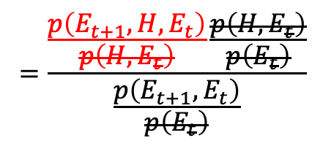
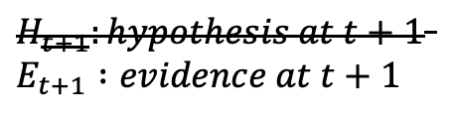
$H_{t}:hypothesis at t$
$E_{t} :evidence at t$
$H_{t+1}:hypothesis at t+1$
$E_{t+1} :evidence at t+1$
$$p\left(H | E_{t+1},E_{t}\right)=\frac{p\left(E_{t+1} | H,E_{t}\right)p\left(H | E_{t}\right)}{p\left(E_{t+1} | E_{t}\right)}$$
경험의 축적?
Update 개념?
빈도 관점 vs 모델 관점
evidence vs parameter
Probability vs function
에르고딕 가정?(현실에서 무한은 존재하지 않는다?)
$$=\frac{\frac{p\left(E_{t+1},H,E_{t}\right)}{p\left(H,E_{t}\right)}\frac{p\left(H,E_{t}\right)}{p\left(E_{t}\right)}}{\frac{p\left(E_{t+1},E_{t}\right)}{p\left(E_{t}\right)}}$$
$$=\frac{p\left(E_{t+1},H,E_{t}\right)}{p\left(E_{t+1},E_{t}\right)}$$
$$E_{t+1}⫫E_{t}$$

Slide 10
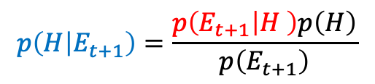
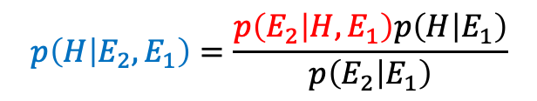
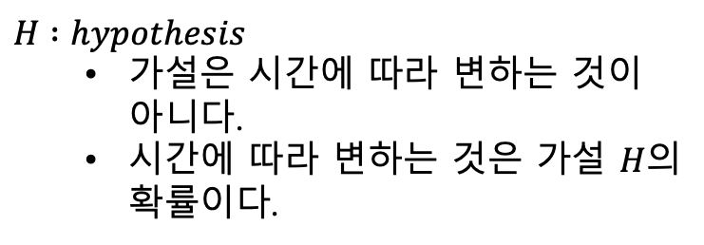
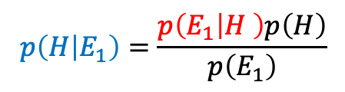
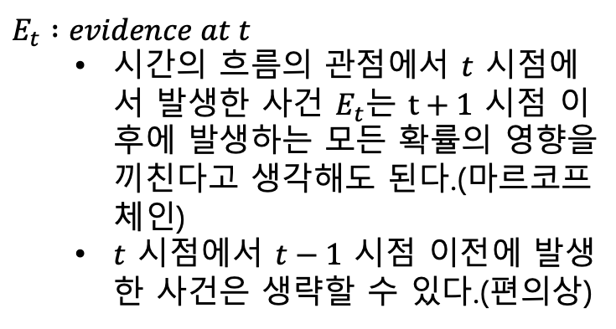
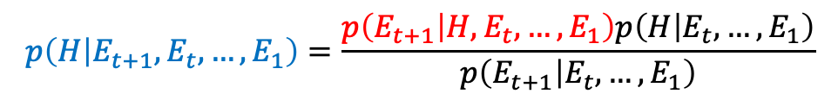
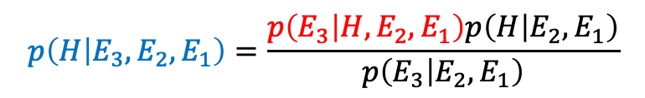
Posterior를 Prior로 사용하기 위한 가정(시간 관점)
$H :hypothesis$
가설은 시간에 따라 변하는 것이 아니다.
시간에 따라 변하는 것은 가설 $H$의 확률이다.
$$p\left(H | E_{1}\right)=\frac{p\left(E_{1} | H \right)p\left(H\right)}{p\left(E_{1}\right)}$$
$E_{t} :evidence at t$
시간의 흐름의 관점에서 $t$ 시점에서 발생한 사건 $E_{t}$는 $t+1$ 시점 이후에 발생하는 모든 확률의 영향을 끼친다고 생각해도 된다.(마르코프 체인)
$t$ 시점에서 $t−1$ 시점 이전에 발생한 사건은 생략할 수 있다.(편의상)
$$p\left(H | E_{2},E_{1}\right)=\frac{p\left(E_{2} | H,E_{1}\right)p\left(H | E_{1}\right)}{p\left(E_{2} | E_{1}\right)}$$
$$p\left(H | E_{3},E_{2},E_{1}\right)=\frac{p\left(E_{3} | H,E_{2},E_{1}\right)p\left(H | E_{2},E_{1}\right)}{p\left(E_{3} | {E_{2},E}_{1}\right)}$$
$$p\left(H | E_{t+1},E_{t},…,E_{1}\right)=\frac{p\left(E_{t+1} | H,E_{t},…,E_{1}\right)p\left(H | E_{t},…,E_{1}\right)}{p\left(E_{t+1} | {E_{t},…,E}_{1}\right)}$$
$$p\left(H | E_{t+1}\right)=\frac{p\left(E_{t+1} | H \right)p\left(H\right)}{p\left(E_{t+1}\right)}$$
or

Slide 11
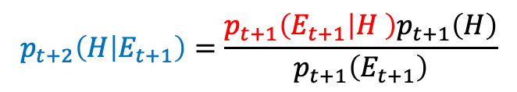
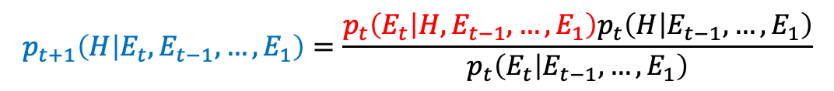
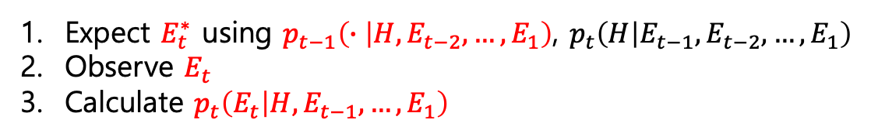
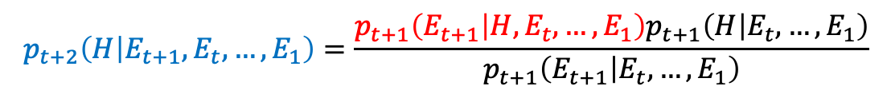
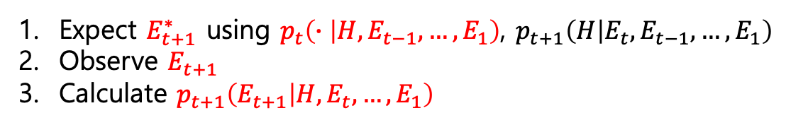
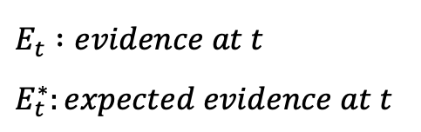
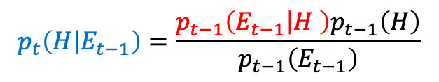
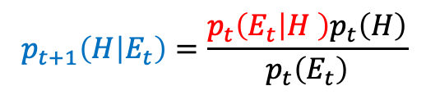
$E_{t} :evidence at t$
$E_{t}^{∗}:expected evidence at t$
Likelihood의 학습?과 수행?(시간 관점)
$$p_{t}\left(H | E_{t−1},E_{t−2},…,E_{1}\right)=\frac{p_{t−1}\left(E_{t−1} | H,E_{t−2},…,E_{1}\right)p_{t−1}\left(H | E_{t−2},…,E_{1}\right)}{p_{t−1}\left(E_{t−1} | {E_{t−2},…,E}_{1}\right)}$$
$$p_{t}\left(H | E_{t−1}\right)=\frac{p_{t−1}\left(E_{t−1} | H \right)p_{t−1}\left(H\right)}{p_{t−1}\left(E_{t−1}\right)}$$
or
Expect $E_{t}^{∗}$ using $p_{t−1}\left(∙ | H,E_{t−2},…,E_{1}\right)$, $p_{t}\left(H | E_{t−1},E_{t−2},…,E_{1}\right)$
Observe $E_{t}$
Calculate $p_{t}\left(E_{t} | H,E_{t−1},…,E_{1}\right)$
$$p_{t+1}\left(H | E_{t},E_{t−1},…,E_{1}\right)=\frac{p_{t}\left(E_{t} | H,E_{t−1},…,E_{1}\right)p_{t}\left(H | E_{t−1},…,E_{1}\right)}{p_{t}\left(E_{t} | {E_{t−1},…,E}_{1}\right)}$$
$$p_{t+1}\left(H | E_{t}\right)=\frac{p_{t}\left(E_{t} | H \right)p_{t}\left(H\right)}{p_{t}\left(E_{t}\right)}$$
or
Expect $E_{t+1}^{∗}$ using $p_{t}\left(∙ | H,E_{t−1},…,E_{1}\right)$, $p_{t+1}\left(H | E_{t},E_{t−1},…,E_{1}\right)$
Observe $E_{t+1}$
Calculate $p_{t+1}\left(E_{t+1} | H,E_{t},…,E_{1}\right)$
$$p_{t+2}\left(H | E_{t+1},E_{t},…,E_{1}\right)=\frac{p_{t+1}\left(E_{t+1} | H,E_{t},…,E_{1}\right)p_{t+1}\left(H | E_{t},…,E_{1}\right)}{p_{t+1}\left(E_{t+1} | {E_{t},…,E}_{1}\right)}$$
$$p_{t+2}\left(H | E_{t+1}\right)=\frac{p_{t+1}\left(E_{t+1} | H \right)p_{t+1}\left(H\right)}{p_{t+1}\left(E_{t+1}\right)}$$
or

Slide 12
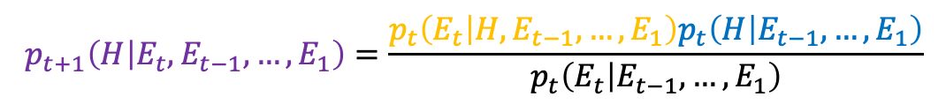
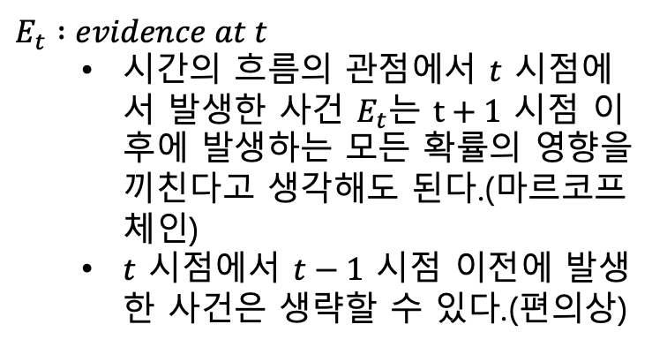
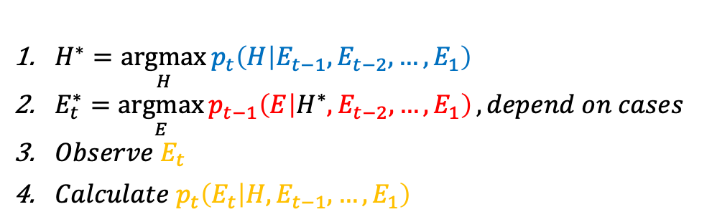



$H :hypothesis$
가설은 시간에 따라 변하는 것이 아니다.
시간에 따라 변하는 것은 가설 $H$의 확률이다.
시간 관점으로 해석한 베이즈 정리
$$p_{t}\left(H | E_{t−1},E_{t−2},…,E_{1}\right)=\frac{p_{t−1}\left(E_{t−1} | H,E_{t−2},…,E_{1}\right)p_{t−1}\left(H | E_{t−2},…,E_{1}\right)}{p_{t−1}\left(E_{t−1} | {E_{t−2},…,E}_{1}\right)}$$
$E_{t} :evidence at t$
시간의 흐름의 관점에서 $t$ 시점에서 발생한 사건 $E_{t}$는 $t+1$ 시점 이후에 발생하는 모든 확률의 영향을 끼친다고 생각해도 된다.(마르코프 체인)
$t$ 시점에서 $t−1$ 시점 이전에 발생한 사건은 생략할 수 있다.(편의상)
$H^{∗}=\underset{H}{argmax}{p_{t}\left(H | E_{t−1},E_{t−2},…,E_{1}\right)}$
$E_{t}^{∗}=\underset{E}{argmax}{p_{t−1}\left(E | H^{∗},E_{t−2},…,E_{1}\right)},depend on cases$
$Observe E_{t}$
$Calculate p_{t}\left(E_{t} | H,E_{t−1},…,E_{1}\right)$
$E_{t}^{∗} :expected evidence at t$
$p_{t}\left(∙\right) :probability at t$
$$p_{t+1}\left(H | E_{t},E_{t−1},…,E_{1}\right)=\frac{p_{t}\left(E_{t} | H,E_{t−1},…,E_{1}\right)p_{t}\left(H | E_{t−1},…,E_{1}\right)}{p_{t}\left(E_{t} | {E_{t−1},…,E}_{1}\right)}$$

Slide 13



$H :hypothesis$
가설은 시간에 따라 변하는 것이 아니다.
시간에 따라 변하는 것은 가설 $H$의 확률이다.
시간 관점으로 해석한 베이즈 정리
$$p_{t}\left(H | E_{t−1}\right)=\frac{p_{t−1}\left(E_{t−1} | H \right)p_{t−1}\left(H\right)}{p_{t−1}\left(E_{t−1}\right)}$$
$E_{t} :evidence at t$
시간의 흐름의 관점에서 $t$ 시점에서 발생한 사건 $E_{t}$는 $t+1$ 시점 이후에 발생하는 모든 확률의 영향을 끼친다고 생각해도 된다.(마르코프 체인)
$t$ 시점에서 $t−1$ 시점 이전에 발생한 사건은 생략할 수 있다.(편의상)
$p_{t}\left(H | E_{t−1}\right) →p_{t}\left(H\right)$
$H^{∗}=\underset{H}{argmax}{p_{t}\left(H\right)}$
$E_{t}^{∗}=\underset{E}{argmax}{p_{t−1}\left(E | H^{∗}\right)}, depend on cases$
$Observe E_{t}$
$Calculate p_{t}\left(E_{t} | H\right)$
$E_{t}^{∗} :expected evidence at t$
$p_{t}\left(∙\right) :probability at t$
$$p_{t+1}\left(H | E_{t}\right)=\frac{p_{t}\left(E_{t} | H \right)p_{t}\left(H\right)}{p_{t}\left(E_{t}\right)}$$

Slide 16






Exploitation(활용)
Choose the action maximizes
$$𝔼\left[r|x,a\right]=\int{𝔼\left[r|x,a,θ\right]P\left(θ | D\right)dθ}$$
$$𝔼_{θ}\left[f|D\right]=\int{f\left(θ\right)p\left(θ | D\right)dθ}$$
Exploration(탐험) & Exploitation(활용)
Action is chosen with probability
$$\int{𝕀\left[𝔼\left[r|x,a,θ\right]=\max_{a^{′}}{𝔼\left[r|x,a^{′},θ\right]}\right]P\left(θ | D\right)dθ}$$
$$𝕀\left[∙\right] is the indicator function$$
$$𝕀_{𝒜}\left[x\right]=\left\{\begin{aligned}1 if x∈𝒜 \\ 0 if x∉𝒜\end{aligned}\right.$$
$$a^{∗}∈𝒜$$
$$𝔼_{θ}\left[𝕀\left[𝔼\left[r|x,a^{∗},θ\right]=\max_{a^{′}}{𝔼\left[r|x,a^{′},θ\right]}\right]|D\right]=\int{𝕀\left[𝔼\left[r|x,a^{∗},θ\right]=\max_{a^{′}}{𝔼\left[r|x,a^{′},θ\right]}\right]P\left(θ | D\right)dθ}$$

